Slide 1
COFFEE SHOPS IN BOSTON
Foundations of Data Analytics
Group 8: The Coffee Shop Industry in Boston
Ana Hatfield, Donika Sollova, Sofiia Tarasiuk, and Yuting Wang

Slide 2
TABLE OF CONTENTS
1
2
3
4
Area of interest and its Importance
Key Questions
Cleaning the Data Set
Statistics
5
6
7
Findings
Limitations
Summary

Slide 3
AREA OF INTEREST
2-3
cups of coffee each day is the average consumption of coffee per coffee drinker in the United States and this is growing.
COFFEE CONSUMPTION IN BOSTON IN 2022
61
coffee shops for every one hundred thousand people in Boston.
1 of 20
of the finest places for coffee in the United States.
Moore, Eric. “U.S. Cities With the Most Coffee Shops.” Overheard on Conference Calls, 13 Jan. 2020, https://overheardonconferencecalls.com/business/cities-most-and-least-coffee-shops/.
Buyinza, Alvin . “Boston Is Still One of the Best Coffee Cities in the US, WalletHub Says.” Masslive, 21 Sept. 2022, https://www.masslive.com/news/2022/09/boston-is-one-of-the-best-coffee-cities-in-us-wallethub-says.html.
MacDonnell, Kate. “19 Coffee Shop Industry Statistics In 2022: Eye-Opening Facts!”, Coffee Affection, 28 Nov.2022, https://coffeeaffection.com/coffee-shop-industry-statistics/

Slide 4
WHY IS THIS IMPORTANT?
Understand
Analyze
To understand the influence of different factors, such as tourism, location, and season on the coffee industry
To analyze changes in the industry
Opportunities
Predict
To predict consumption in the upcoming years
To analyze the viability of opening a coffee shop in Boston
Learn More
To learn more about consumer behavior surrounding coffee shops

Slide 5
KEY QUESTIONS
COFFEE SHOPS
ECONOMICS FACTORS
TOURISM
ATTRIBUTES
COVID-19
How do economic factors, such as inflation, impact the coffee shop industry?
What influences an increase in consumer demand in the coffee shop industry?
How has COVID-19 and its related restrictions and behaviors impacted coffee shops?
Does tourism play a role in the number of visits to coffee shops?

Slide 6
CLEANING THE DATA SET FOR USE
LEFT JOIN
SELECT COLUMNS
NAICS CODE
KEYWORDS
FULL JOIN
TOP 5
Place and Patterns Data Sets
placekey
location_name
postal_code
date_range_start
date_range_end
raw_visit_counts
naics_code
street_address
naics_code = 722515
Subcategory: Snack and Nonalcoholic Beverage Bars
Starbucks
Coffee
Cafe
Nero
Cup
Espresso
Dunkin’
Cappuccino
Full join the keywords into one data set that contains all coffee shops
Based on visit count
Dunkin’
Starbucks
Caffe Nero
Tatte Bakery & Cafe
Cuppacoffee

Slide 7
TOP 5 SUMMARY STATISTICS
OBSERVATIONS
MEAN VISITS
POSTAL CODES
TOTAL VISITS
875
264.9931
21
Dunkin’: 121,548
Starbucks: 72,233
Tatte: 19,597
Caffe Nero: 14,233
Cuppacoffee: 4,257

Slide 8
ARE THERE REALLY THAT MANY SHOPS IN BOSTON?
DUNKIN’ | 454
STARBUCKS | 250
CAFFE NERO | 109
TATTE BAKERY & CAFE | 46
FLOUR BAKERY & CAFE | 22
CUPPACOFFEE | 16
DUNKIN’ | 62
STARBUCKS | 38
CAFFE NERO | 14
TATTE BAKERY & CAFE | 6
FLOUR BAKERY & CAFE | 4
CUPPACOFFEE | 2

Slide 9
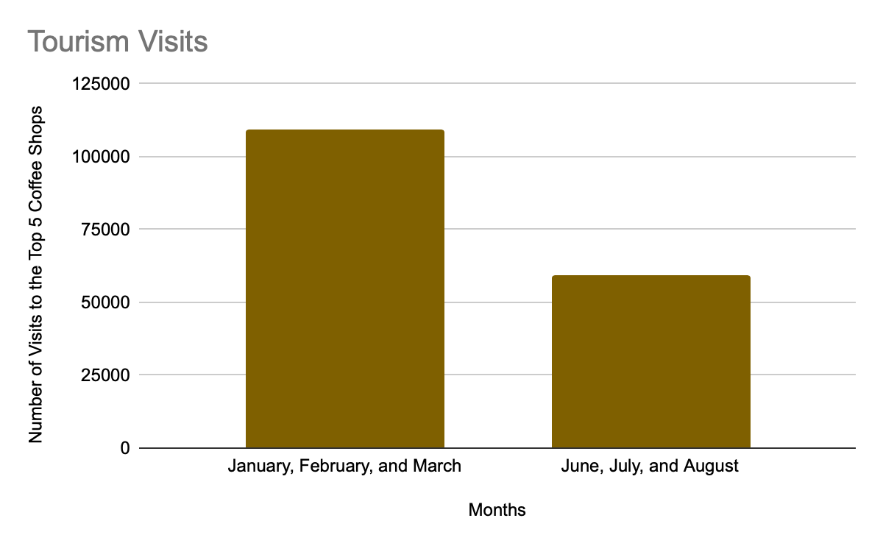
TOURISM FINDINGS
Does tourism play a role in the number of visits to coffee shops?

Slide 10
ATTRIBUTES FINDINGS
What impacts consumption?
Top Shops Based on Visit Count | Total Visit Counts
Dunkin’ | 121,548
Starbucks | 72,233
Tatte | 19,597
Caffe Nero | 14,233
Cuppacoffee | 4,257
Top Shops Based on Location Number | Number of Locations in Boston
Dunkin’ | 62
Starbucks | 38
Caffe Nero | 14
Tatte | 6
Flour Bakery & Cafe | 3
Cuppacoffee | 2

Slide 11
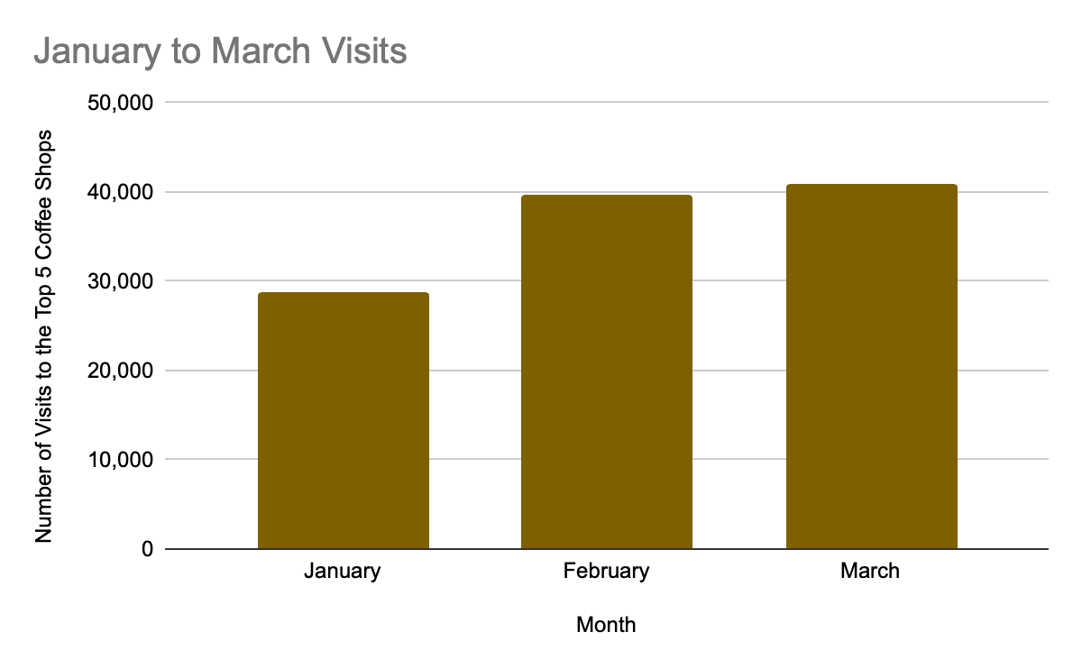
COVID-19 FINDINGS
What is the impact of COVID-19 related policies?

Slide 12
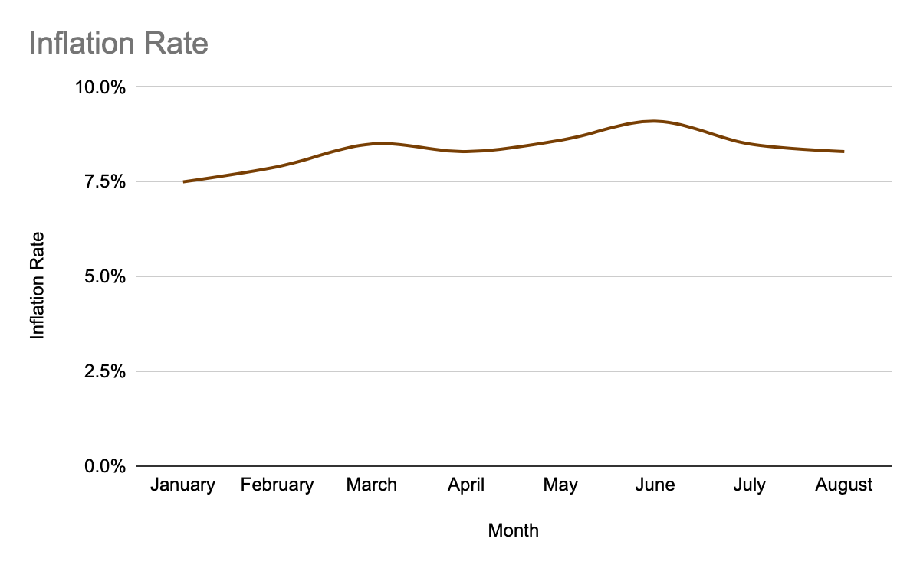
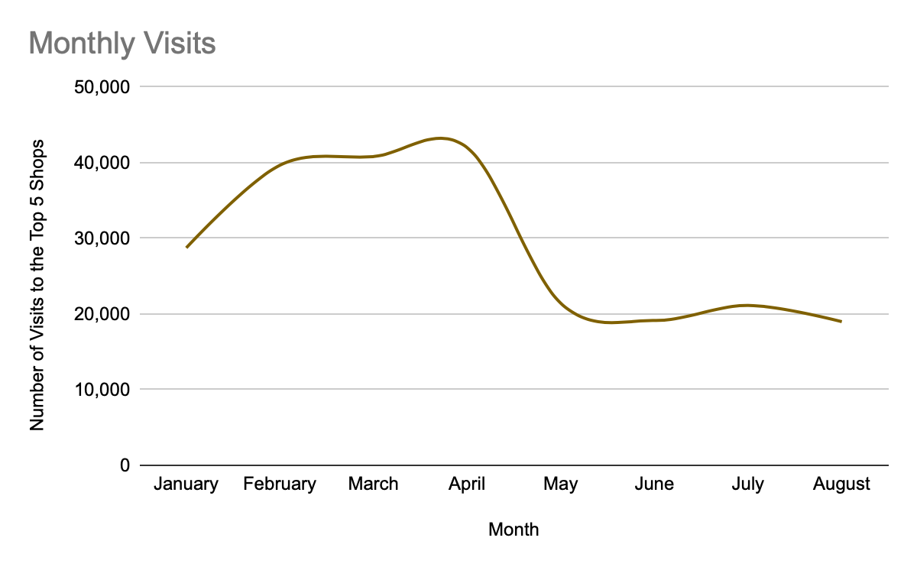
ECONOMIC FINDINGS
What is the impact of inflation on visiting behavior?
“Monthly Inflation Rate U.S. 2022.” Statista, https://www.statista.com/statistics/273418/unadjusted-monthly-inflation-rate-in-the-us/.

Slide 13
LIMITATIONS
Monthly Differences
Method of Data Collection
When we try to compare month-by-month, the number of observations were different.
Some people might have zero or multiple smartphones. Due to this, the behavior of these consumers is not correctly captured by the data set.
Time Period of Data Set
Outside Variables
The data set only captures information from January 2022 to August 2022. A more time encompassing data set would allow for more robust and indicative results.
There are some variables that also affect coffee shops, such as social norms, personal preferences, and so on that could not be captured here.

Slide 14
SUMMARY
The highest number of visits was seen in April and the lowest was August.
Tourism does not heavily impact visit counts.
Number of locations and visit counts have a positive correlation.
As consumers felt like COVID-19 was less present, they were more eager to go out for a coffee.
When the inflation rate is high, the amount of visitors has decreased.

Slide 15
THANK YOU FOR YOUR TIME!
ANY QUESTIONS?

